Slide 1
2018 True-Luxury Global Consumer Insight
5th Edition
SARAH WILLERSDORF
New York, 9th May, 2018

Slide 2
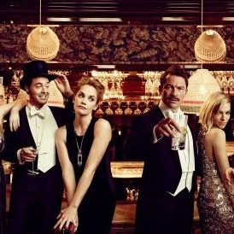
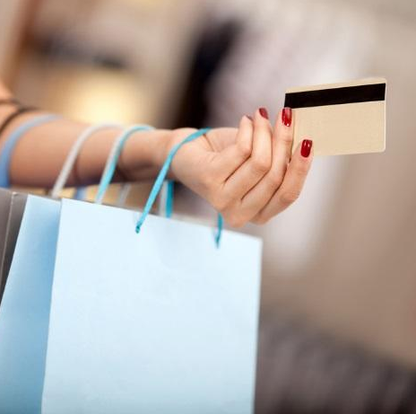
The BCG-Altagamma True-Luxury Global Consumer insight panel
Fifth Ed. 2018
12,000+
+1,000 in China
+1,000 in US
~€37K
Average spend
10
Largest worldwide luxury Markets
Source: BCG-Altagamma True-Luxury Global Consumer Insight Survey 2017 (12K + respondents in 10 countries)

Slide 3
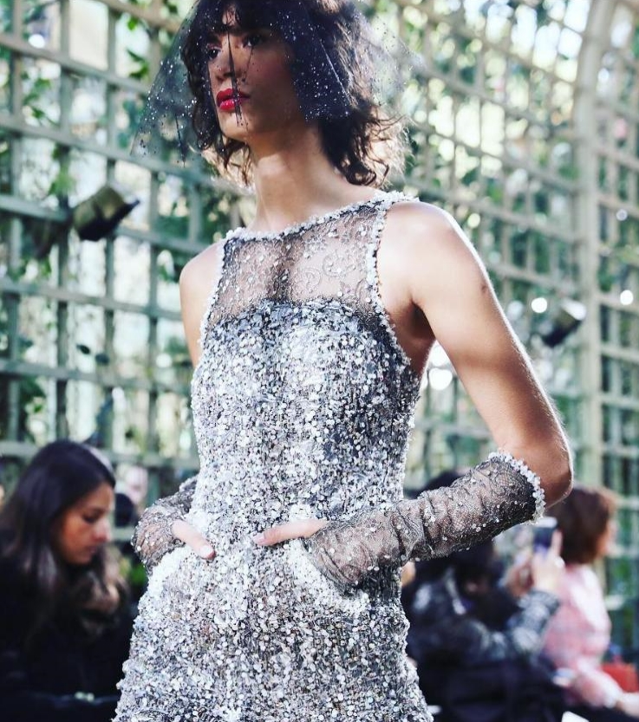
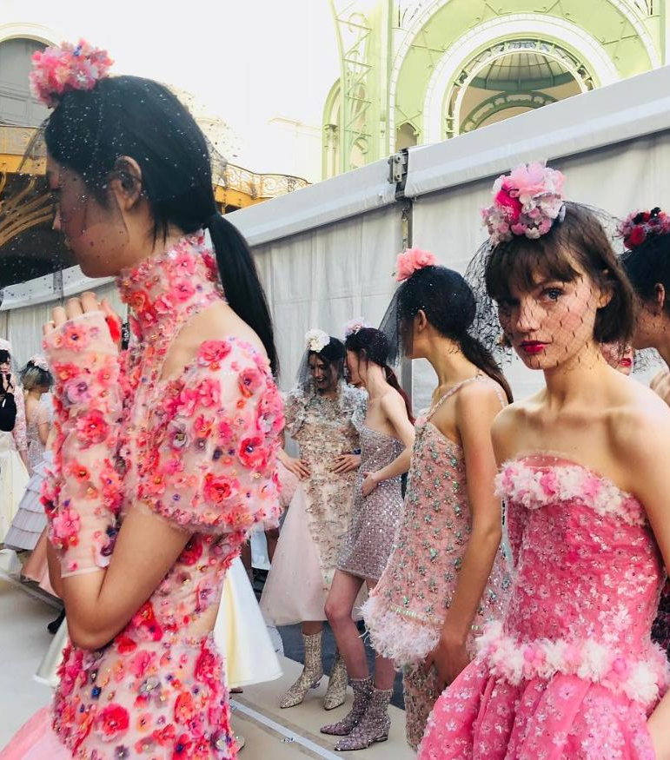
Market
True-Luxury Global Consumer Insight
Consumer Insights

Slide 4
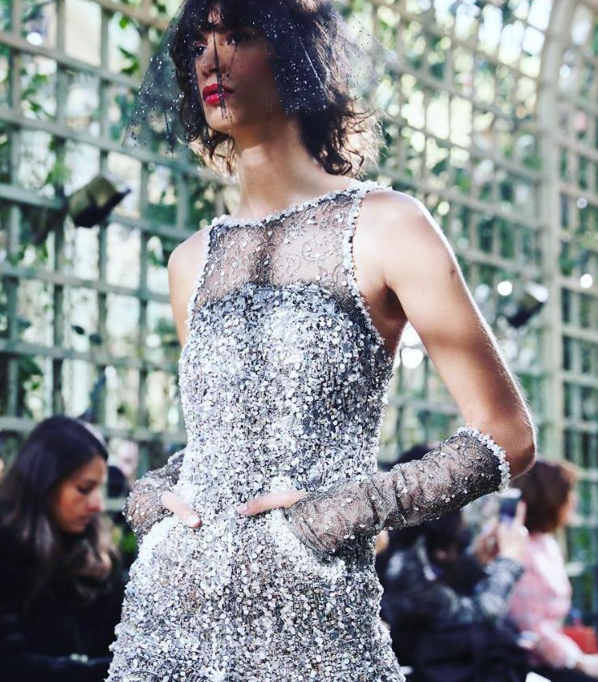
Market
True-Luxury Global Consumer Insight
Consumer Insights

Slide 5
18 M True Luxury Consumers generating ~30% of global market, expected to further polarize in the next years
Cluster
2017
2024
# (M)
Bn(€)
# (M)
Bn(€)
50 k€
Beyond money
0.4
22
0.6
41
20 k€
Top Absolute
1.4
33
2.2
54
10 k€
Absolute
4.9
98
6.5
145
5 k€
Entry Absolute
11.3
115
13.9
155
18
267
29%
23
31%
Total True-Luxury
395
+128
2 k€
Top Aspirational
21
65
28
93
Other Aspirational
375
580
445
772
+192
Total Luxury
Consumers
~414
~913
~496
~1.260
Note: Including personal and experiential luxury, excluding cars and yachts
Source: BCG Luxury Market Model
+347
4

Slide 6
2 most relevant avenues of growth for the Personal Luxury market
50% of the market made by Millennials by 2024
40% of the market
made by Chinese by 2024
409
409
Age Today
25
327
327
43
Silent (70+ yrs)
9
34
Other
23
Baby Boomers (51-70 yrs)
85
Other APAC
36
65
Japanese
33
Europeans
59
80
Gen. X (36-50 yrs)
Americans
72
Millennials (21-35 yrs)
50%
40%
29%
32%
162
Gen. Z (5-20 yrs)
Chinese
105
10
2017
2024F
2017
2024F
130%
70%
Of the growth will be driven by Millennials
Of the growth will be driven by Chinese
Note: Relative to Personal Luxury
Source: BCG Luxury market model

Slide 7
Market
True-Luxury Global Consumer Insight
Consumer Insights

Slide 8
10 trends relevant for the True-Luxury Consumers
1. Luxury casualwear: keeps increasing vs formal with 73% appeal, +7pp YoY, also driven by "forever young" behaviors
2. Luxury product values: traditional values as quality hold but new values as "extravagance & fun" key to success
3. Collaborations: cover demand for newness, give a cool edge, strengthen brand awareness & willingness to buy
4. Mix and match: ~55% Millennials partially shift from luxury brands to trade down or mix styles buying niche brands
5. Brand loyalty: Millennials the generation with highest brand loyalty across categories - 36% are loyal vs. 30% overall
Product & Branding
"What they want"
6. Social media: social media keep booming - from 9th in 2013 to 1st lever in 2017 on True-Luxury consumers
7. Influencers: within social media, influencer power booming because of perceived authenticity
"How to reach them"
Communication & Media
8. Omnichannel: achieved ~50%. Online-solo keeps growing with older consumers. Store-solo shows signs of recovery
9. Online ecosystem: evolving with regional differences (brand.com vs multi-brand vs generalist marketplaces shares)
10. Mono-brand stores: stabilizing due to luxury brands' efforts –"Special product" offer, in-store experience improvement
Sales
Channels
"Where they buy"
Source: BCG-Altagamma True-Luxury Global Consumer Insight Survey 2017 (12K + respondents in 10 countries)

Slide 9
Luxury casualwear confirmed as a major trend, especially for 'Forever Young' generations
Luxury Casualwear
1
Global market trends
73% vs 66% last year moving toward casual luxury
By Generation
Forever Young
No change towards luxury casualwear
22%
13%
34%
27%
33%
29%
28%
+7pp
Shift towards luxury casualwear
78%
87%
66%
73%
67%
71%
72%
2016
2017
Gen. Z
Millennials
Gen. X
Baby Boomers
Silver
Source: BCG-Altagamma True-Luxury Global Consumer Insight Survey 2017 (12K + respondents in 10 countries)

Slide 10
Luxury casualwear the "new normal": driven by formal saturation & comfort for older, by coolness for young
Luxury Casualwear
1
Global market trends
"Thinking about formalwear / casualwear which of the following statements best apply to you?"
By generation
All
Gen. Z
Millennials
Gen. X
Baby Boomer
Silver
73%
67%
71%
72%
78%
87%
Shift towards Luxury casualwear
Reasons why…
Now suitable / accepted in more
occasions, even at work
48%
43%
46%
43%
43%
49%
I wear casual during my free time
37%
34%
38%
38%
34%
27%
Formalwear saturation
31%
30%
28%
30%
39%
49%
More comfortable
27%
20%
21%
24%
33%
43%
Represents my personal branding
and I feel cooler
25%
24%
23%
22%
16%
13%
Source: BCG-Altagamma True-Luxury Global Consumer Insight Survey 2017 (12K + respondents in 10 countries)

Slide 11
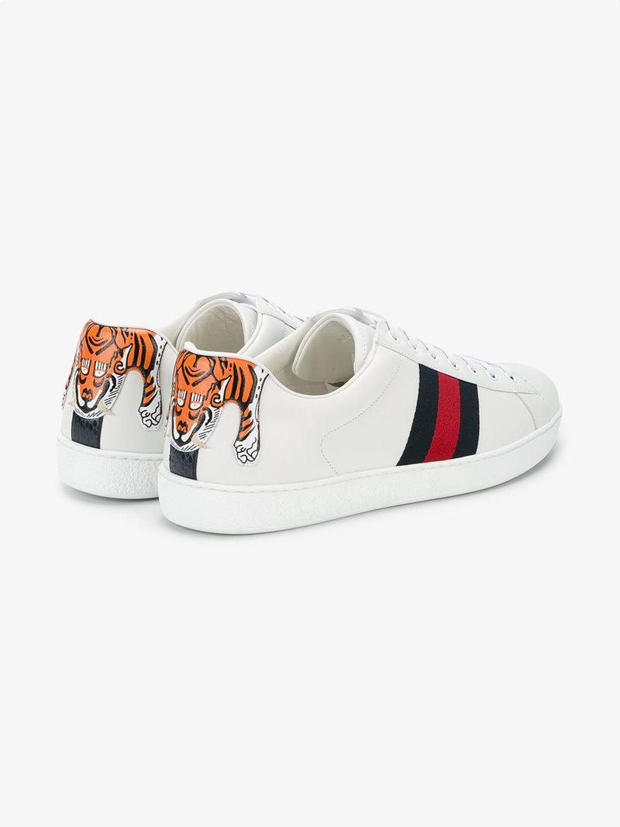
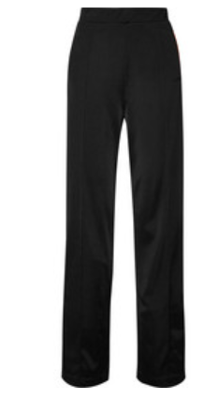
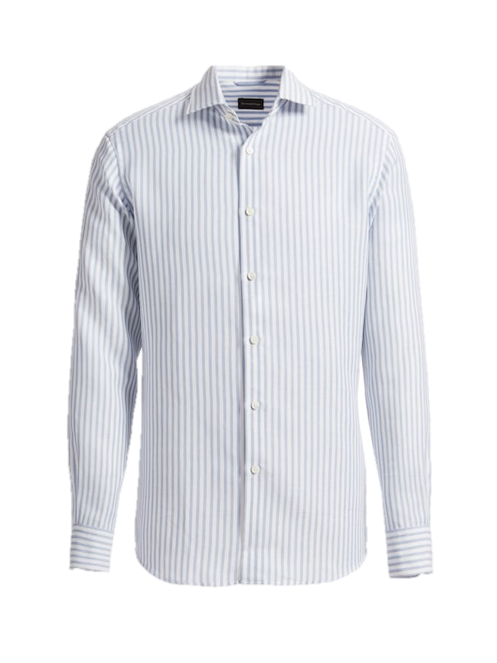
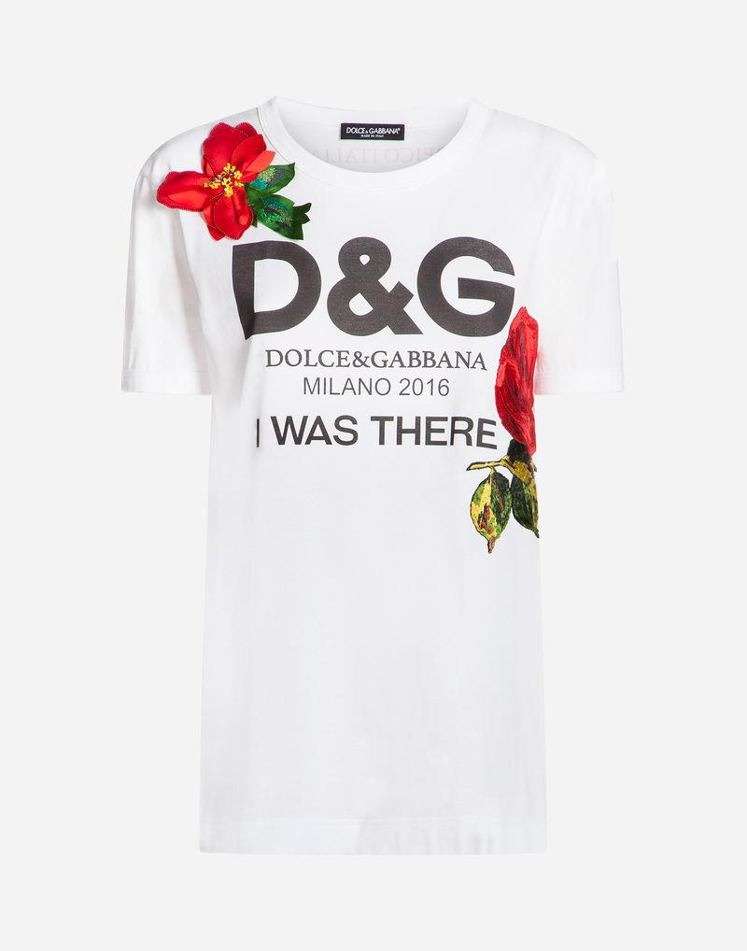
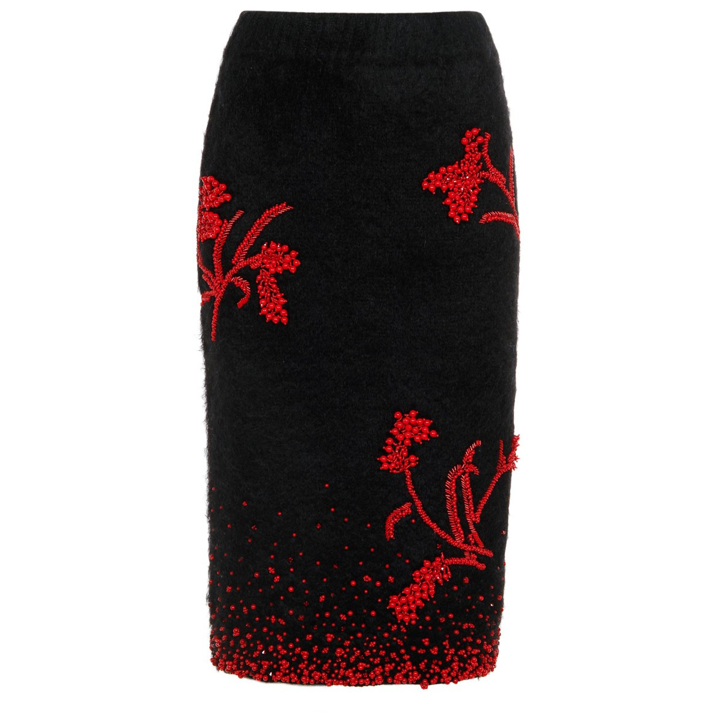
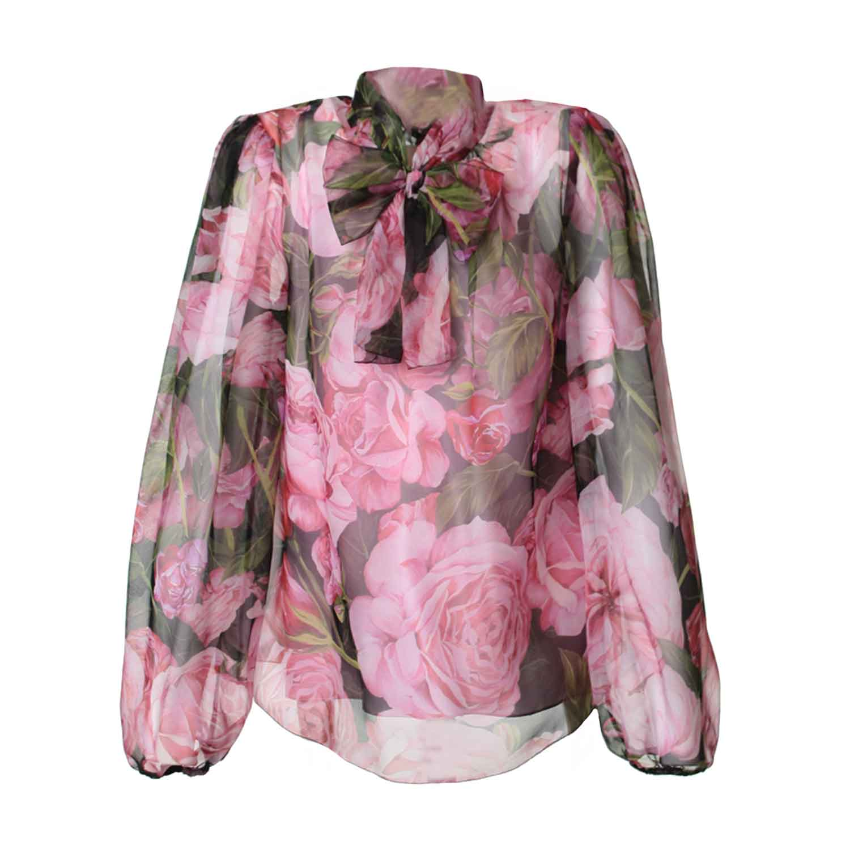
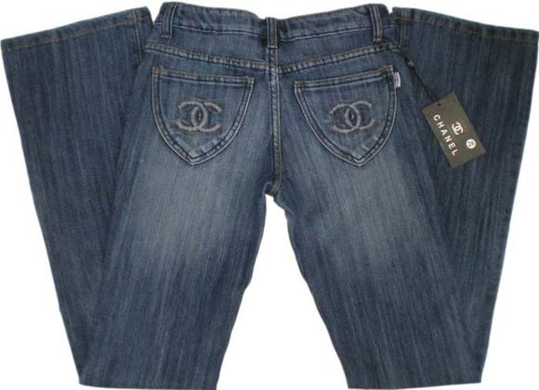
Among top 5 future luxury spending categories True-Luxury Consumers do see 3 casual oriented ones
Luxury Casualwear
1
Global market trends
In which categories will your spending on luxury goods be affected the most and in which direction?
Index: % People expecting to increase spending - % of people expecting to decrease spending in that category
Balanced Casual & Formal
Biased to Casual
Pants & Skirts
Shirts
Sneakers
T-Shirt
Jeans
+39%
+38%
+37%
+35%
+34%
Overall True-Luxury consumers
expected spending increase
Top 5 categories
Source: BCG-Altagamma True-Luxury Global Consumer Insight Survey 2017 (12K + respondents in 10 countries)

Slide 12
Traditional luxury values still predominant, however new values key for success amongst Chinese & Millennials
Luxury product values
2
Global market trends
Overall True-Luxury Consumers
Millennials
Traditional luxury values
Superior quality
Craftsmanship
Exclusivity
...
77%
71%
78%
79%
73%
New luxury values
Extravagant & fun
Identity statement
Cool & sexy
...
29%
23%
22%
21%
27%
Extravagant & fun
Craftsmanship
Timeless
Cool & sexy
Highest positive difference vs. overall
An identity statement
Heritage
Craftsmanship
Innovation
Highest negative difference vs overall
Exclusivity
Brand iconic patterns
Adorned aesthetics
Craftsmanship
Adorned aesthetics
Extravagant & fun
Exclusivity
Superior quality
Source: BCG-Altagamma True-Luxury Global Consumer Insight Survey 2017 (12K + respondents in 10 countries)

Slide 13
88% of True-Luxury Consumers aware of collaborations, Generation Z and Millennials reaching ~94%
Collaborations
3
Millennials
88% are aware of collaborations
By Generation
Baby Boomers
Gen. Z
Millennials
Gen. X
Silver
Not aware
12%
6%
6%
10%
24%
42%
Aware
88%
94%
94%
89%
76%
58%
2017
Source: BCG-Altagamma True-Luxury Global Consumer Insight Survey 2017 (12K + respondents in 10 countries)

Slide 14
Collaborations with streetwear & artists have a positive impact on young generations and no impact on older ones
Collaborations
3
Millennials
"Thinking about special editions realized in collaboration with different brands / artists,
which of the following statements best applies to you?"
% of respondents
Overall
By Generation
Gen. Z
Millennials
Gen. X
Baby Boomer
Silver
88%
94%
94%
90%
76%
58%
Aware of Collaborations
Cool, new different styles
32%
49%
40%
30%
15%
8%
Special and unique collections
26%
25%
26%
29%
21%
14%
Something new without changing identity
15%
11%
15%
16%
17%
9%
Indifferent
14%
6%
9%
13%
31%
55%
Negative impact
3%
2%
2%
3%
7%
8%
Note: Selected most important answers
Source: BCG-Altagamma True-Luxury Global Consumer Insight Survey 2017 (12K + respondents in 10 countries)

Slide 15
Additionally, collaborations have a positive impact on the willingness to buy for ~55% of True-Luxury Consumers
Collaborations
3
Millennials
What is the impact of collaborations in your willingness to buy from the brand?
Overall
Gen. Z
Millennials
Gen. X
Baby Boomer
Silver
55%
61%
62%
57%
32%
12%
Willingness to buy Index¹
Increase in my willingness to buy the main collection
33%
37%
35%
34%
24%
23%
Increase in my willingness to buy the collaboration collection
34%
33%
36%
35%
28%
13%
Decrease in willingness to buy from the brand
12%
9%
9%
11%
20%
24%
1. % "Positive influence on my willingness to buy repeatedly from the collaboration’s collection" + %"Positive influence on my willingness to buy from the brand’s main collection" - %"Negative impact on long-term customers like myself: I do not recognize the brand or want to buy from it anymore"
Note: Selected most important answers
Source: BCG-Altagamma True-Luxury Global Consumer Insight Survey 2017 (12K + respondents in 10 countries)

Slide 16
The mix & match trend attains ~54% for millennials
Mix & Match
4
Millennials
"Thinking about your spending of 2/3 years ago and that of the last 12 months, do you have the feeling that you have partially shifted your spending from luxury brands to premium / fast fashion / niche or sports brands?
By Generation
47% of respondents have shifted from top luxury brands
Baby Boomers
Gen. Z
Millennials
Gen. X
Silver
23%
Shifted
41%
+6pp
47%
45%
52%
54%
77%
Not shifted
59%
53%
55%
48%
46%
2016
2017
Source: BCG-Altagamma True-Luxury Global Consumer Insight Survey 2017 (12K + respondents in 10 countries)

Slide 17
~54% of Millennials shift from luxury brands; they trade down or mix styles buying niche brands
Mix & Match
4
Millennials
~54% of Millennials shift from top luxury brands
Relevant categories
Millennials
Luxury sports niche¹
22%
Sneakers, Backpacks, T-shirts
Yes
54%
Shifting niche
Luxury niche²
23%
Formal shoes, Sunglasses, Perfumes
26%
T-Shirts, Shirts, Jeans
Fast fashion
No
46%
Trading down
Premium
29%
Handbags, Perfumes, Watches
2017
2017
1. e.g. Lululemon or Sweaty Betty 2. e.g. Acne Studios, Mr & Mrs Italy, Aquazurra ecc
Source: BCG-Altagamma True-Luxury Global Consumer Insight Survey 2017 (12K + respondents in 10 countries)

Slide 18
Although they mix & match, Millennials are the most loyal generation across luxury brand categories
Brand loyalty
5
Millennials
True-Luxury Consumers
Baby Boomers
Gen. Z
Millennials
Gen. X
Silver
Loyal
31%
36%
Unloyal
69%
64%
Is there a brand on which you will increase your luxury spending?
39%
41%
44%
39%
28%
21%
Source: BCG-Altagamma True-Luxury Global Consumer Insight Survey 2017 (12K + respondents in 10 countries)

Slide 19
Social Media rank as 1st influence lever on True-Luxury Consumers, +29pp vs 2013 and +1pp vs 2016
Social Media
Global market trends
6
"Which of the following online sources of information / channels impact how you develop opinions or make decisions about luxury purchases?"
2013
2016
2017
2
Magazines
50%
Magazines
39%
Social Media & Influencers
39%
Store windows
3
39%
Social Media & Influencers
Magazines
37%
Brand websites
34%
Brand websites
33%
Brand websites
31%
Word of Mouth
Store windows
26%
Store windows
27%
TV & Movies
24%
TV & Movies
23%
Word of Mouth
Events
20%
Word of Mouth
19%
TV & Movies
20%
Celebrities
20%
Events
17%
Events
14%
Seen Worn
1
13%
Celebrities
16%
Seen Worn
14%
Social Media & Influencers
Seen Worn
12%
Celebrities
13%
Influencers
Social media
Note: Multiple options answer (ranking of three levers)
1. Includes Social Media, Online blogs & Influencers; 2. Editorials and Commercial in Magazines. Includes both traditional & digital magazines; 3. Includes also Brand's App
Source: BCG-Altagamma True-Luxury Global Consumer Insight Survey 2017 (12K + respondents in 10 countries)

Slide 20
Instagram gaining space vs. Facebook and Youtube in the West; Wechat, Weibo and QQ leading among Chinese
Social Media
Global market trends
6
How would you rank the social media you use when interacting
with luxury brands, fashion bloggers?
Western world¹
Chinese world
2017
Vs. 2016
2017
Vs. 2016
1
65%
70%
Tencent - Wechat
2
53%
55%
Weibo
3
48%
40%
1. Includes: US, UK, Italy, France, Germany and Brazil
Source: BCG-Altagamma True-Luxury Global Consumer Insight Survey 2017 (12K + respondents in 10 countries)
Tencent - QQ

Slide 21
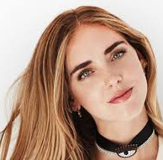
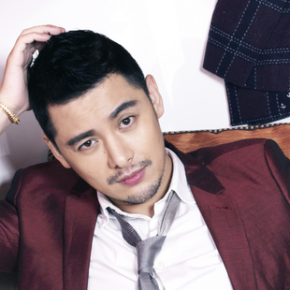
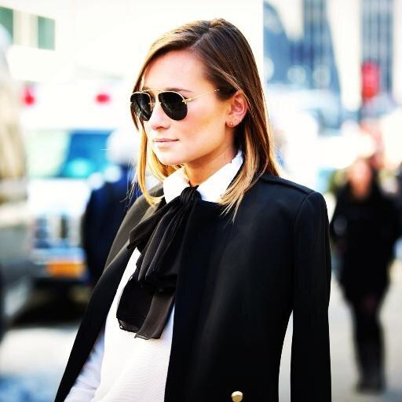
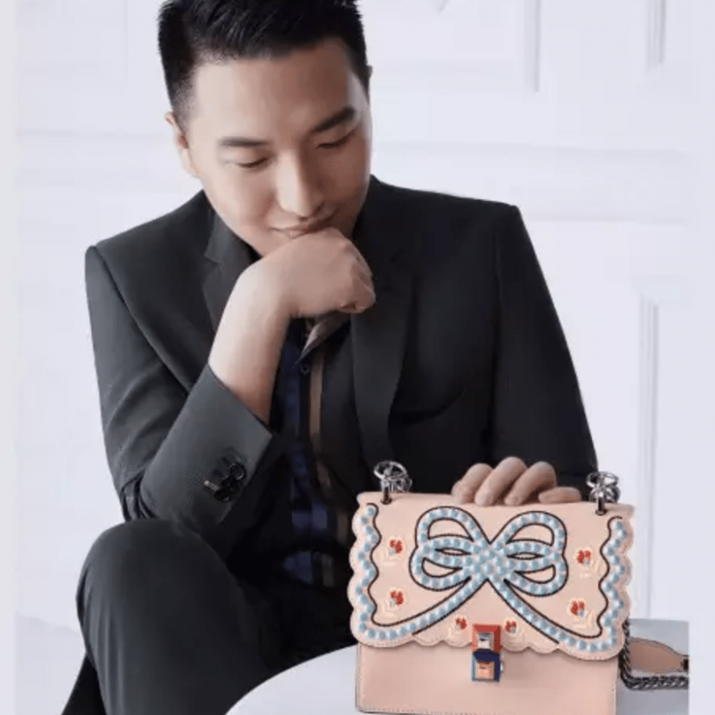
Influencers
Global market trends
7
West
China
Chiara
Ferragni
Gogoboi
The power of influencers does not lie in their follower count, but in their ability to influence through perceived authenticity, a unique point of view and storytelling
Will Influencer-led content creation and power represent a challenge for luxury brands?
Danielle
Bernstein
Aimee
Song
Who is your favorite Influencer
Aimee
Song
Chiara
Ferragni
?
Sincerely
Jules
Becky's Fantasy
Negin Mirsalehi
Mr. Bags
Source: BCG-Altagamma True-Luxury Global Consumer Insight Survey 2017 (12K + respondents in 10 countries); BCG Analysis

Slide 22
Omnichannel stabilizing, Online-solo up with early signs of store recovery
Omnichannel
Omnichannel
8
Global market trends
8
Global market trends
Last purchase channel evolution
Last purchase channel evolution
2017
48%
Omnichannel
12%
12%
100%
100%
7%
Online solo
7%
Online solo
10%
10%
9%
8%
9%
Showrooming
8%
Showrooming
39%
39%
46%
46%
51%
38%
51%
ROPO
38%
ROPO
42%
42%
Omnichannel
Omnichannel
40%
40%
47%
Store solo
47%
Store solo
39%
39%
1
1
2
2013
2
2013
2016
2016
Store-solo
Store-solo
ROPO
ROPO
Showrooming
Showrooming
Online-solo
Online-solo
Total
Total
1. Researched Online, Purchased Offline
2. Researched Offline, Purchased Online
Note: referred to last purchase
Source: BCG-Altagamma True-Luxury Global Consumer Insight Survey 2017 (12K + respondents in 10 countries)
1. Researched Online, Purchased Offline
2. Researched Offline, Purchased Online
Note: referred to last purchase
Source: BCG-Altagamma True-Luxury Global Consumer Insight Survey 2017 (12K + respondents in 10 countries)
Notes:
1. Signs of Store-solo stabilization driven by US True Luxury Consumers & younger generations
2. Omnichannel stabilizing for the 1st year, however future growth expected to come from Millennials 'Omni' attitude
3. Online-solo continues to grow driven mainly by older generations in mature countries

Slide 23
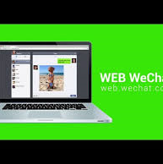
3 channels dominate True-Luxury online ecosystem, counting for ~90%
Online ecosystem
9
Global market trends
Luxury online ecosystem dominated by Mono-brand online, Full price multi-brand & Generalist marketplaces (~90% of the last purchases online)
Mono-brand online preferred in mature markets & by older generations, Generalist strong in China and Multi-brand amongst Millennials
Online ecosystem varies broadly across luxury categories
33%
32%
23%
Mono-brand website
(e.g. Brand.com)
Full price multi-brand
(e.g. NAP, Farfetch)
Generalist marketplaces
(e.g. Amazon, T-mall, Alibaba, JD)
6%
4%
2%
Off price
e-tailers
(e.g Yoox)
Online
flash sales
(e.g. Vente-privee, VIP)
Social Media linked sales (e.g. WeChat, C2C)
Note: referred to last purchase
Source: BCG-Altagamma True-Luxury Global Consumer Insight Survey 2017 (12K + respondents in 10 countries)

Slide 24
Mobile prevailing over PC for online shopping, driven by Chinese and youth; further increases expected
Online ecosystem
9
Global market trends
"Which device did you use to buy this item online?"
All True-Luxury Consumers
From Generation Z … to Silver
… to Chinese
27%
19%
55%
55%
66%
75%
77%
Device (smartphone, tablet)
80-90%
73%
81%
45%
45%
34%
25%
23%
10-20%
Personal computer (laptop)
2014
2017
2024E
Gen. Z
Millennials
Gen. X
Baby Boomers
Silver
Note: Referred to last purchase; % of people using device vs. personal computer / people buying online
Source: BCG-Altagamma True-Luxury Global Consumer Insight Survey 2017 (12K + respondents in 10 countries)

Slide 25
Mono-brand still the most used channel by True-Luxury Consumers, gaining back some ground vs Dept. Stores
Mono-brand store
10
Global market trends
"Which kind of store did you buy the product from?"
Reasons to purchase in mono-brand stores
True-Luxury Global Consumers
Online
16%
19%
20%
#1
Try & touch the product
Other Physical Stores
7%
6%
6%
Shopping mall
6%
7%
6%
#2
Offer range of the brand
High-end dept store
20%
22%
17%
#3
Intimate and relaxed environment
Multi-brand
16%
19%
19%
#4
Convenient location, easy reach
Mono-brand
35%
27%
32%
#5
Personal relationship with sales associate
2014
2016
2017
Note: Referred to last purchase
Source: BCG-Altagamma True-Luxury Global Consumer Insight Survey 2017 (12K + respondents in 10 countries)

Slide 26
Brands efforts to offer special editions & new experiences in store drive consumers to increase visits to mono-brands
Mono-brand store
10
Global market trends
Which are the reasons for which you are and would purchase more frequently in a mono-brand physical store?
ranking
% of respondents
True-Luxury Global Consumers
Latest products including special editions
#1
27%
Sales associate gives me advice on latest trends
#2
21%
Products I cannot find online
#3
21%
Offers experiences in store
#4
20%
Unique event in store to which I am invited
#5
20%
Reasons related to experiences, special products
Store has different product assortments in each city I visit
#6
19%
Other reasons
Source: BCG-Altagamma True-Luxury Global Consumer Insight Survey 2017 (12K + respondents in 10 countries)

Slide 27
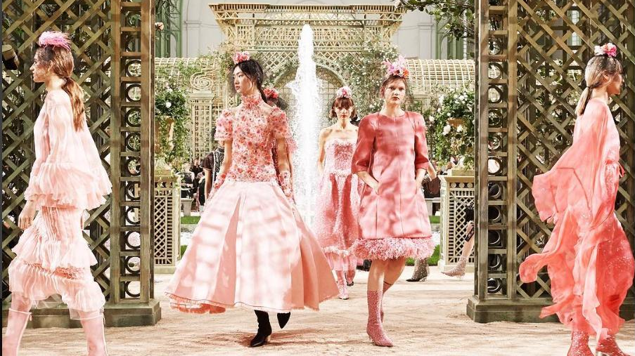
Thank you
bcg.com

Slide 29
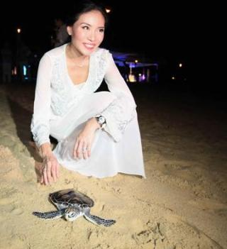
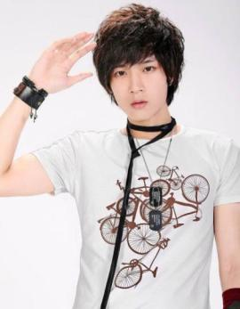
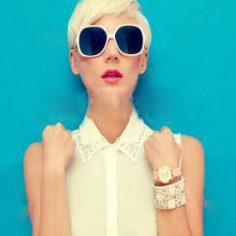
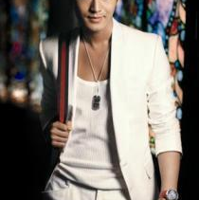
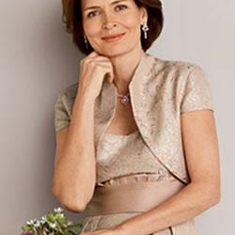
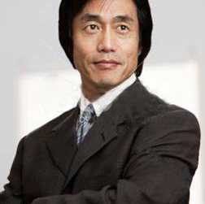
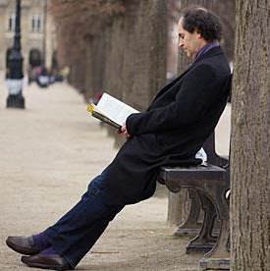
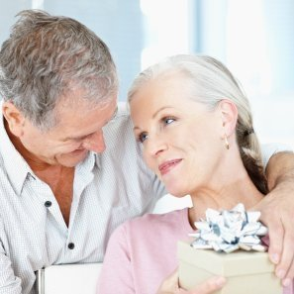
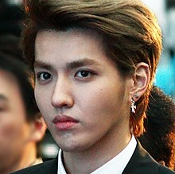
We have been exploring behavior of Luxury consumers for the last 5 years, focusing on the True-Luxury Consumers
True-Luxury Global Consumers
segmentation by spending level
True-Luxury Global Consumers
Behavioral segmentation
Beyond money
50 k€
Absolute Luxurer
Social Wearer
#LITTLE PRINCE
Expe- riencer
Top Absolute
20 k€
Absolute
10 k€
Fashionista
Status Seeker
Timeless Proper
Mega- citier
Entry Absolute
5 k€
Class-pirational
Luxe Immune
Omni- gifter
Rich Upstarter
Aspirational
Source: BCG-Altagamma True-Luxury Global Consumer Insight Survey 2017 (12K + respondents in 10 countries)

Slide 30
Made-in
Global market trends
Made-in Italy still leading, fueled by apparel, handbags and shoes
Which country of manufacturing do you consider the best for luxury products?
Respondents preference on made-in¹ (%)
Overall
2014–2017
Clothing
Handbags & shoes
Cosmetics & perfumes
Δ 2014–2017 (pp)
30%
12
+17 pp
+18 pp
-2 pp
22%
4
19%
36%
20%
38%
15%
14%
11%
3
2014
2017
2014
2017
2014
2017
10%
0
+3 pp
+2 pp
+15 pp
-4
35%
50%
7%
14%
17%
16%
18%
5%
-1
2014
2017
2014
2017
2014
2017
…
+2 pp
+2 pp
+1 pp
3%
-2
10%
12%
10%
2014
2017
2014
2017
2014
2017
1. Excluding cars, luxury boats, design and lighting
Source: BCG-Altagamma True-Luxury Global Consumer Insight Survey 2017 (12K + respondents in 10 countries)

Slide 31
Made-in
Global market trends
Made-in Italy recognized worldwide, however Made-in France preferred in China, Brazil & France
Made-in preference by consumer nationality
Respondents (%)
Focus on personal luxury¹
80
40
20
0
Overall
Made in Italy
Made in France
Made in US
1. Excluding cars, luxury boats, design and lighting
Source: BCG-Altagamma True-Luxury Global Consumer Insight Survey 2017 (12K + respondents in 10 countries)

Slide 32
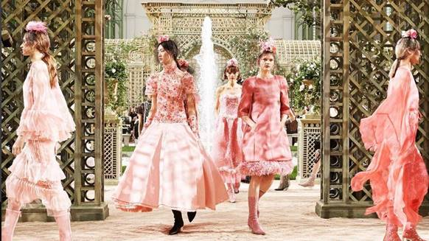
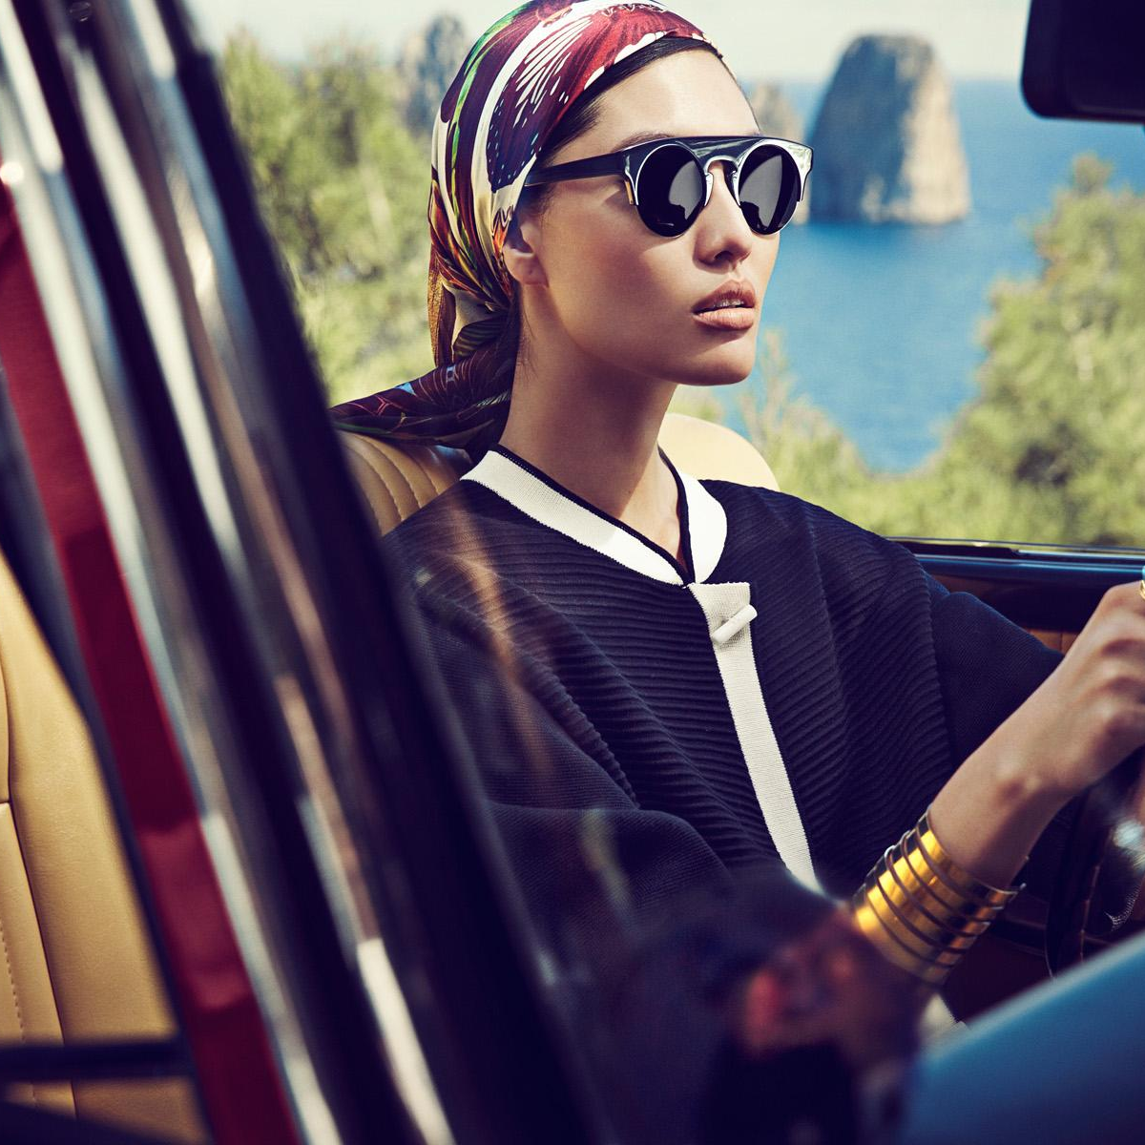
1
2
Focus: Millennials
Product & Branding
True Luxury Consumers Global market trends
"What they want"
3
Focus: Chinese
"How to reach them"
Communication & Media
Sales
Channels
"Where they buy"

Slide 33
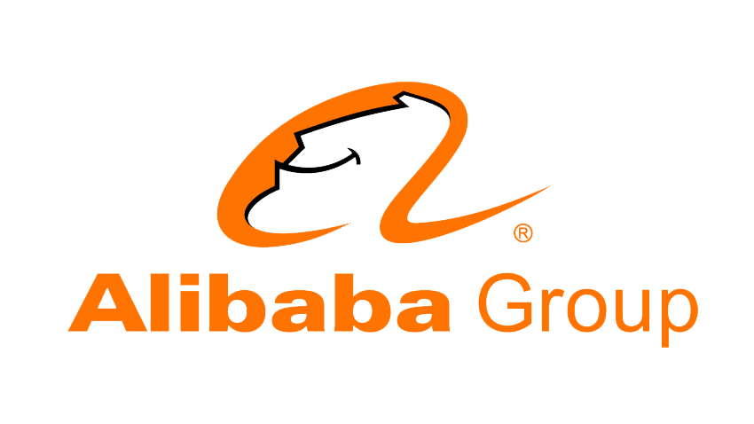
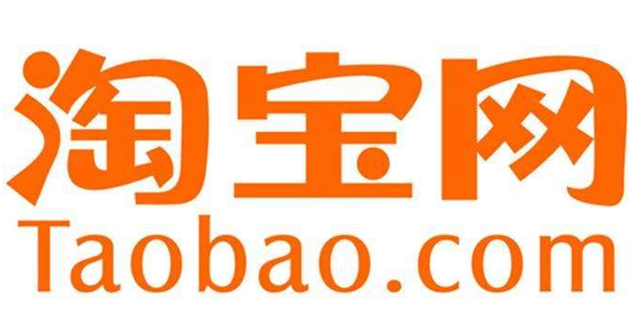
China's digital ecosystem is highly integrated and dominated by two players
Online ecosystem
9
China
Connectivity & Content focused
Digital commerce focused
Social & Content
Online e-commerce
E-commerce
Finance
Logistics
Finance
Games
Music
QQ
Wechat
Video
News
Cloud service
Local Life
Cloud service
Local Life
Car-hailing
Food delivery
Entertainment
Food delivery
Source: BCG Analysis

Slide 34
Social Media rank as the 1st influence lever, followed by Word of Mouth & Brands websites
Social Media
6
China
"Which of the following online sources of information / channels impact how you develop opinions or make decisions about luxury purchases?"
Chinese
True-Luxury Consumers 2017
2017
2016
1
Social Media & Influencers
10%
39%
Social Media & Influencers
35%
14%
49%
Social Media & Influencers
46%
2
Magazines
37%
Word of mouth
30%
Magazines
3
Brand websites
31%
Brand websites
29%
Brand websites
30%
Store windows
27%
Magazines
26%
Word of Mouth
27%
Word of Mouth
Store windows
20%
Store windows
TV & Movies
20%
TV & Movies
Celebrities
Events
14%
Events
20%
TV & Movies
20%
Seen Worn
14%
Celebrities
20%
Events
20%
Celebrities
13%
Influencers
Seen Worn
9%
Seen Worn
9%
Social media
Note: Multiple options answer (ranking of five levers) 1. Includes Social Media, Online blogs & Influencers; 2. Editorials and Commercial in Magazines. Includes both traditional & digital magazines; 3. Includes also Brand's App
Source: BCG-Altagamma True-Luxury Global Consumer Insight Survey 2017 (12K + respondents in 10 countries)

Slide 35
Chinese True-Luxury Consumers increasingly use Social Media
Social media
China
6
Do you use Social Media to interact with luxury brands?
Chinese's interaction with luxury brands through Social Media is increasing and already higher if compared with other countries consumers' interaction
Chinese
RoW¹
No
Yes, once a week or less
4%
21%
-14pp
Yes, 2-3 times a week
Yes, once a day
7%
9%
Yes, many times per day
+14pp
1. Rest of the World
Source: BCG-Altagamma True-Luxury Global Consumer Insight Survey 2017 (12K + respondents in 10 countries)

Slide 36
Within online sources, Brand Social Media 1st, influencers 3rd
Social media
China
6
"Which of the following online sources of information / channels impact how you develop opinions or make decisions about luxury purchases?"
Social Media & Influencers' relevance driven not only by consumers but also by the ecosystem and by investments from platforms
It will be key for Luxury brands to partner with Social Media platform
True-Luxury Global Consumers
Chinese
Ranking
Brand’s website
29%
26%
+9pp
Official brand’s social media pages
18%
1
27%
Advertising or articles in online magazines
16%
12%
+7pp
Influencers and fashion bloggers
13%
3
20%
Digital communication from the brand¹
13%
11%
Online blogs
12%
10%
Brand’s mobile App
11%
12%
Instant chat services
9%
12%
Source: BCG-Altagamma True-Luxury Global Consumer Insight Survey 2017 (12K + respondents in 10 countries)

Slide 37
Social media: Tencent's WeChat helps brands influence consumers along the entire shopping journey
Social media
China
6
Reach
Engage
Convert
Transaction
After-sales & CRM
Moments Ads
Fan recruitment: target audience through user tags
"@ brand" feature: engage with fans in the ad's comment box
WeChat Pay: direct in-place payment option
Official Accounts
3rd party accounts: Native, tailor-made ads
Own account: engage fans with self-generated content
Omni-channel enhancement
Mini programs: link customers to brand O2O experience, both in-store and for after-sale service
WeCard
WeChat Pay: attracts users to go from online to offline
Customized deals & gift cards
WeChat Index
Insights into user interests to help brands communicate useful content on "social hotspots". Keyword trends, article-reading habits, and word-of-mouth monitoring analytics
Source: BCG Analysis

Slide 38
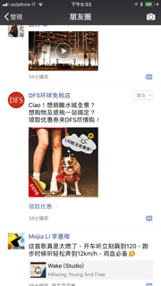
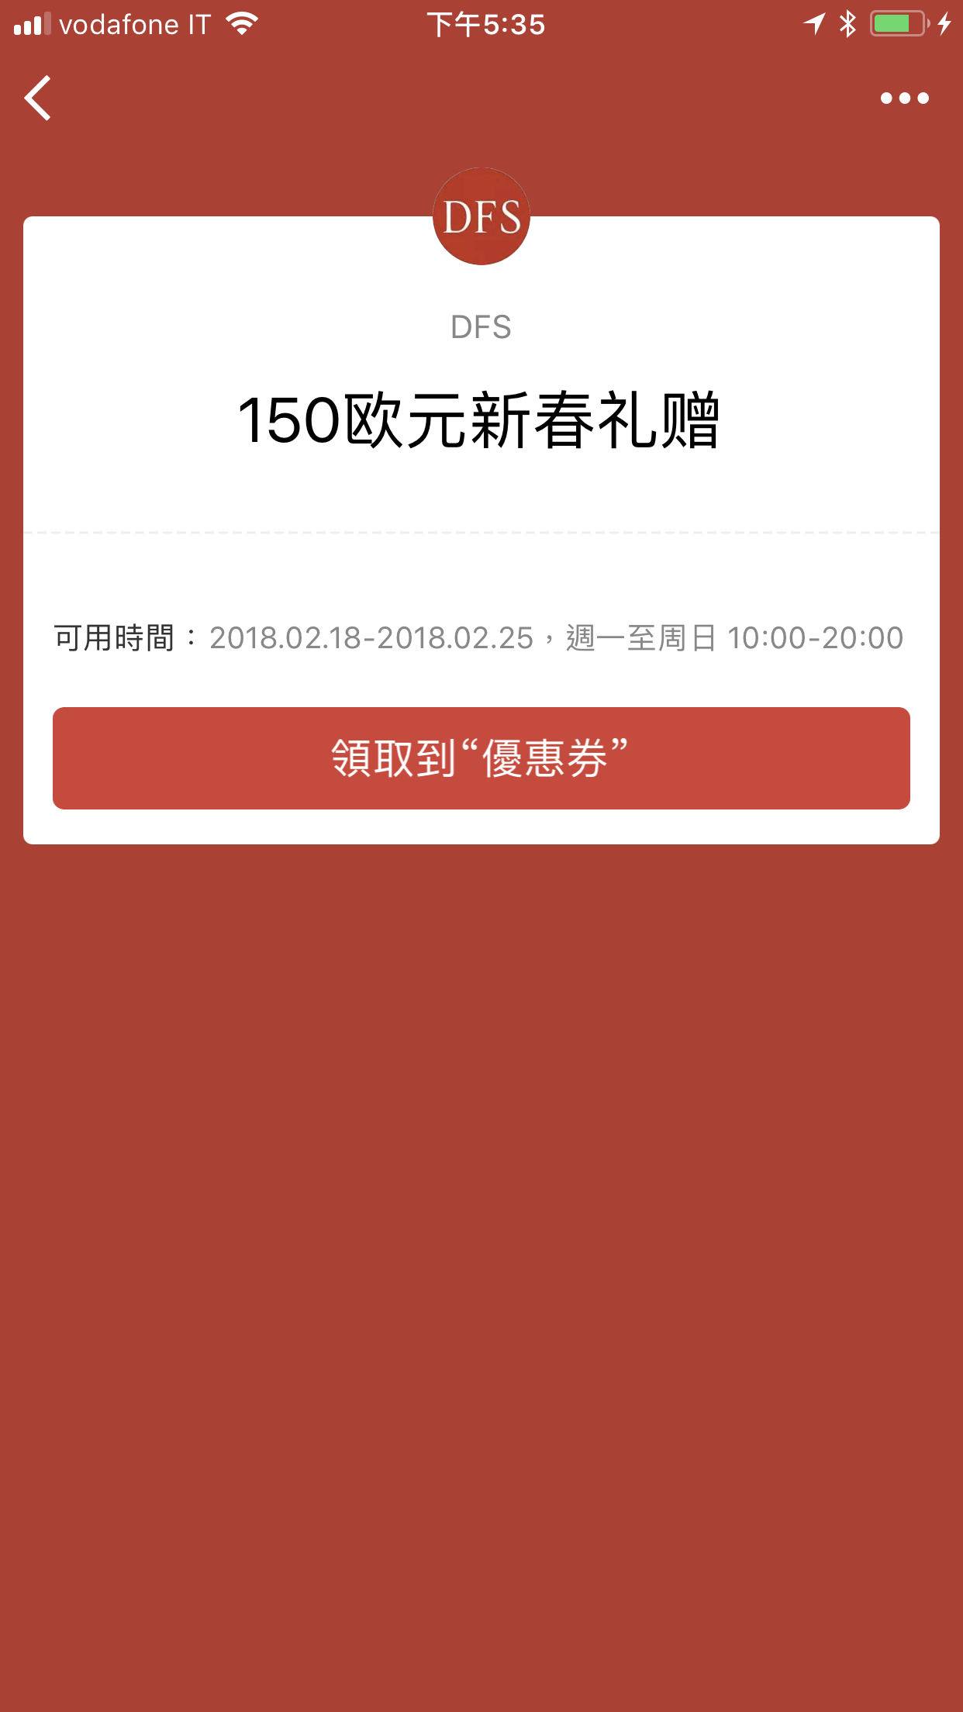
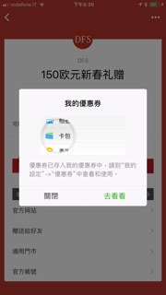
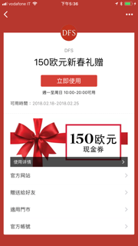
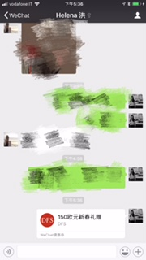
Moments Ads: engage with fans and potential customers on China's most widely used social sharing platform
Social media
China
6
'@brand' feature: interact with loyal fans
Integrate into EC campaign with WeChat Pay
'Fans Recruit': reach potential customers
Special Event
Campaign
Customized purchase experience

Slide 39
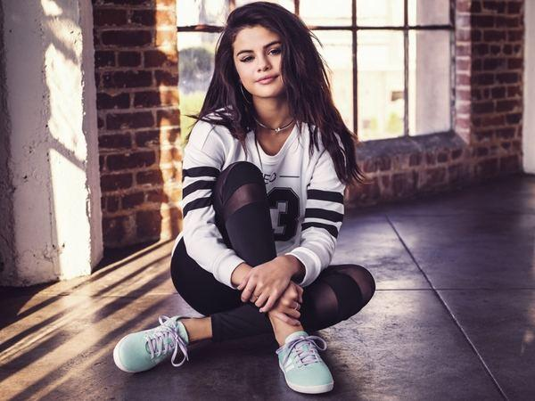
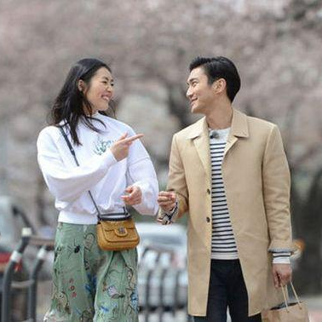
Digital content: Tencent's content ecosystem reaches and engages a wide range of potential customers
Social media
China
6
Reach
Engage
Convert
Transaction
After-sales & CRM
Tencent News Room
Penguin Media Platform/Online Media Group: co-create and distribute branded, social-native content)
Live Broadcasting
Social apps: immersive social, entertainment and news event live broadcasting, with KOL and celebrity network
Push product reservation opportunities to customers
Music Platform
QQ Music: banner + native ads for target listeners
IP Co-Operation
Content ecosystem: embed innovative ads into Tencent's hottest games and movies/shows, incorporating celebrities and scenario relevance for social buzz
Online TV
Penguin TV: engage with high-income TA on the big screen, enhancing interaction and exposure
Source: BCG Analysis

Slide 40
Chinese ROPO over indexed due to online struggles
Omnichannel
8
China
Chinese consumers more 'Omni' than True Luxury Consumers (~61% vs 48%)
Omnichannel relevance driven by higher ROPO & by not yet attractive Online Solo alternative
Online Solo struggle to emerge due to counterfeit products' fear & the lack of a worthy luxury experience on the mass market platforms
True-Luxury Global Consumers
Chinese
48%
61%
Omnichannel
12%
100%
Omnichannel
7%
100%
9%
10%
39%
51%
40%
31%
Store-solo
ROPO
1
Showrooming
2
Online-solo
Total
Store-solo
ROPO
Showrooming
Online-solo
Total
1. Researched Online, Purchased Offline
2. Researched Offline, Purchased Online
Source: BCG-Altagamma True-Luxury Global Consumer Insight Survey 2017 (12K + respondents in 10 countries)

Slide 41
Chinese: some brands well ahead of competition
China
~25 brands included in the analysis¹
“Is there a brand on which you have reduced / you will reduce your luxury spending?
Is there a brand on which you have increased / you will increase your luxury spending?”
Satisfaction Index = % respondents who will increase their spend - % respondents who will reduce their spend
Chinese
Consumers
True Luxury
Consumers
1
22
3
11
9
5
19
14
6
7
10
8
15
4
17
2
12
16
23
18
21
20
13
24
xx = Brand Ranking for True-Luxury Consumers
1. Chosen brands with at least 5 respondents per brand
Note: Satisfaction Index = % respondents who will increase their spend - % respondents who will reduce their spend
Source: BCG-Altagamma True-Luxury Global Consumer Insight Survey 2017 (12K + respondents in 10 countries)

