Slide 1
Luxury FirstLook
True-Luxury Global Consumer Insight
January 16th, 2019

Slide 2
4-5% of Luxury Consumers generate ~30% of global market; 10% generates 39%
Cluster
2017
2024
# (M)
Bn(€)
# (M)
Bn(€)
50 k€
Beyond money
0.4
22
0.6
41
20 k€
Top Absolute
1.4
33
2.2
54
10 k€
Absolute
4.9
98
6.5
145
5 k€
Entry Absolute
11.3
115
13.9
155
18
267
29%
23
31%
Total True-Luxury
395
+128
2 k€
Aspirational-Luxury
21
65
28
93
Acessible-Luxury
375
580
445
772
+192
Total Luxury
Consumers
~414
~913
~496
~1.260
Note: Including personal and experiential luxury, excluding cars and yachts
Source: BCG Luxury Market Model
+347
1

Slide 3
2 most relevant avenues of growth for the Personal Luxury market
50% of the market made by Millennials by 2024
40% of the market
made by Chinese by 2024
409
409
Age Today
25
327
327
43
Silent (70+ yrs)
9
34
34%
Other
23
Baby Boomers (51-70 yrs)
85
Other APAC
36
65
Japanese
33
20%
39%
Europeans
59
80
Gen. X (36-50 yrs)
22%
Americans
72
Millennials (21-35 yrs)
50%
40%
29%
32%
162
Gen. Z (5-20 yrs)
Chinese
105
10
2024F
2024F
130%
70%
Of the growth will be driven by Millennials
Of the growth will be driven by Chinese
Note: Relative to Personal Luxury
Source: BCG Luxury market model

Slide 4
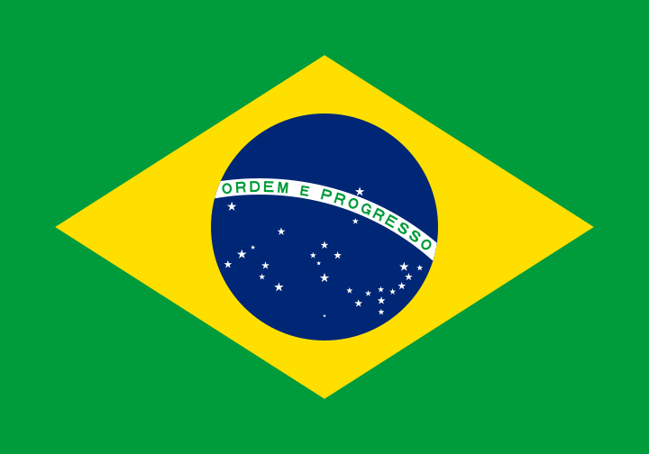
Luxury spend increasingly local/regional; even more so for US True-Luxury consumers
Where did you buy your last luxury product?
True-Luxury Consumers
By Country
By Generation
Baby Boomers
Millen.
Gen. X
Silver
29%
29%
20-25%
Abroad
20%
41%
39%
51%
71%
71%
75-80%
Local
80%
59%
61%
49%
2014
2015
2016
2017
2024E
Note: referred to last purchase
Source: BCG-Altagamma True-Luxury Global Consumer Insight Survey (12K + respondents in 10 countries)

Slide 5
Luxury casualwear confirmed as a major trend, especially for 'Forever Young' generations
Luxury Casualwear
1
Global market trends
73% vs 66% last year moving toward casual luxury
By Generation
Forever Young
No change towards luxury casualwear
22%
13%
34%
27%
33%
29%
28%
+7 pp
Shift towards luxury casualwear
78%
87%
66%
73%
67%
71%
72%
Gen. Z
Millennials
Gen. X
Baby Boomers
Silver
Source: BCG-Altagamma True-Luxury Global Consumer Insight Survey (12K + respondents in 10 countries)

Slide 6
Luxury casualwear the "new normal": driven by formal saturation & comfort for older, by coolness for young
Luxury Casualwear
1
Global market trends
"Thinking about formalwear / casualwear which of the following statements best apply to you?"
By generation
All
Gen. Z
Millennials
Gen. X
Baby Boomer
Silver
73%
67%
71%
72%
78%
87%
Shift towards Luxury casualwear
Reasons why…
Now suitable / accepted in more
occasions, even at work
48%
43%
46%
43%
43%
49%
I wear casual during my free time
37%
34%
38%
38%
34%
27%
Formalwear saturation
31%
30%
28%
30%
39%
49%
More comfortable
27%
20%
21%
24%
33%
43%
Represents my personal branding
and I feel cooler
25%
24%
23%
22%
16%
13%
Source: BCG-Altagamma True-Luxury Global Consumer Insight Survey (12K + respondents in 10 countries)

Slide 7
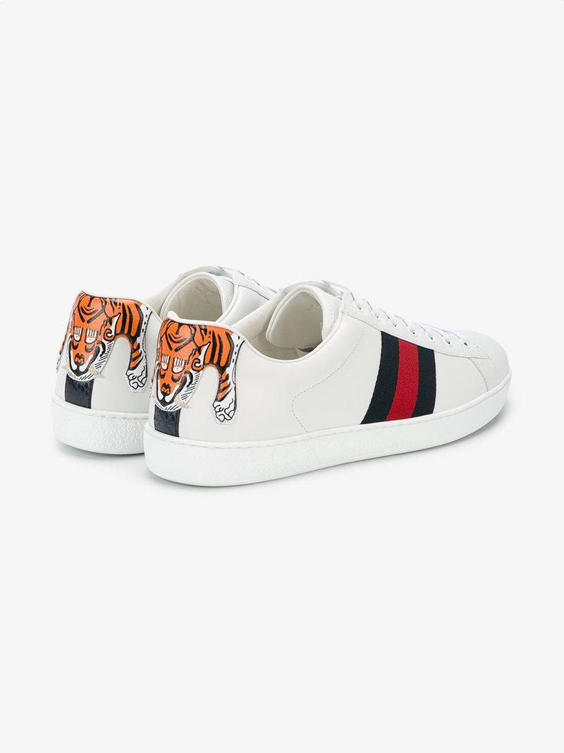
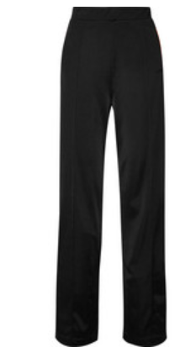
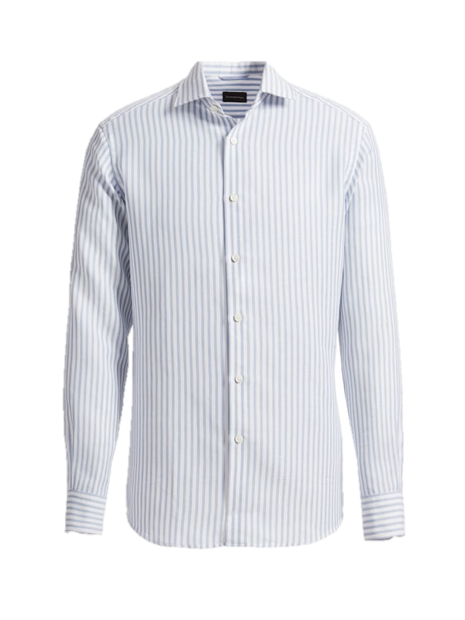
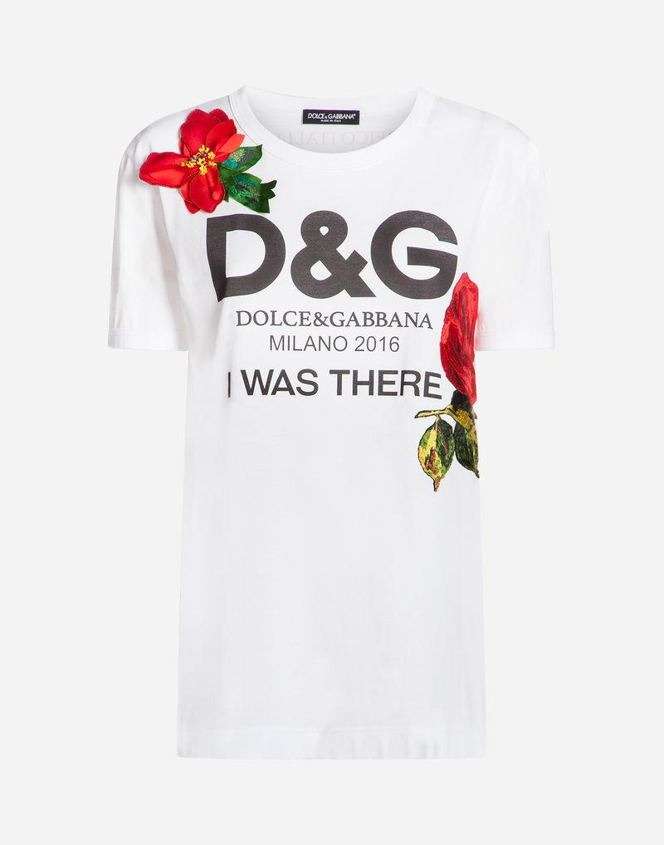
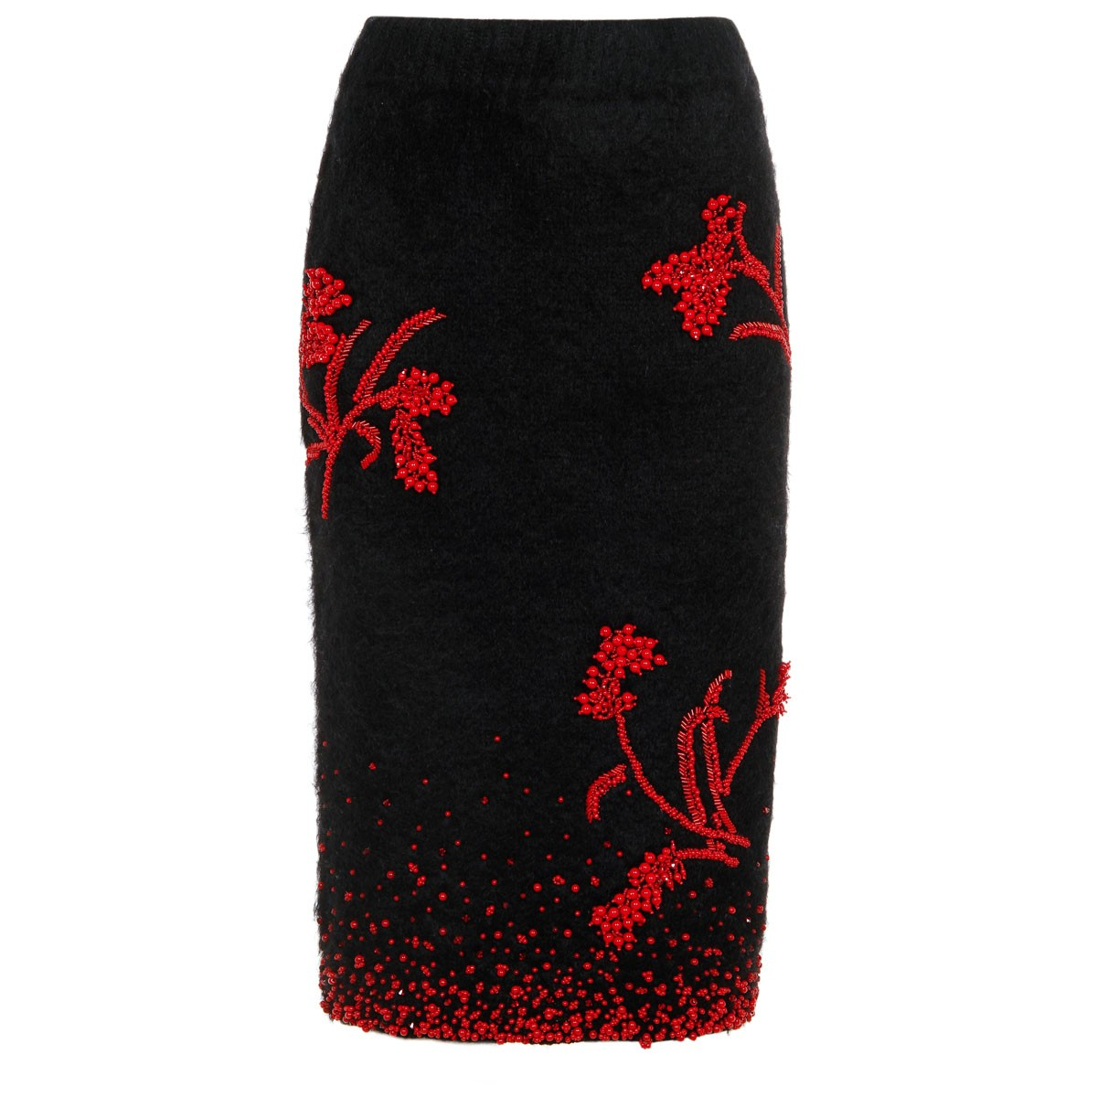
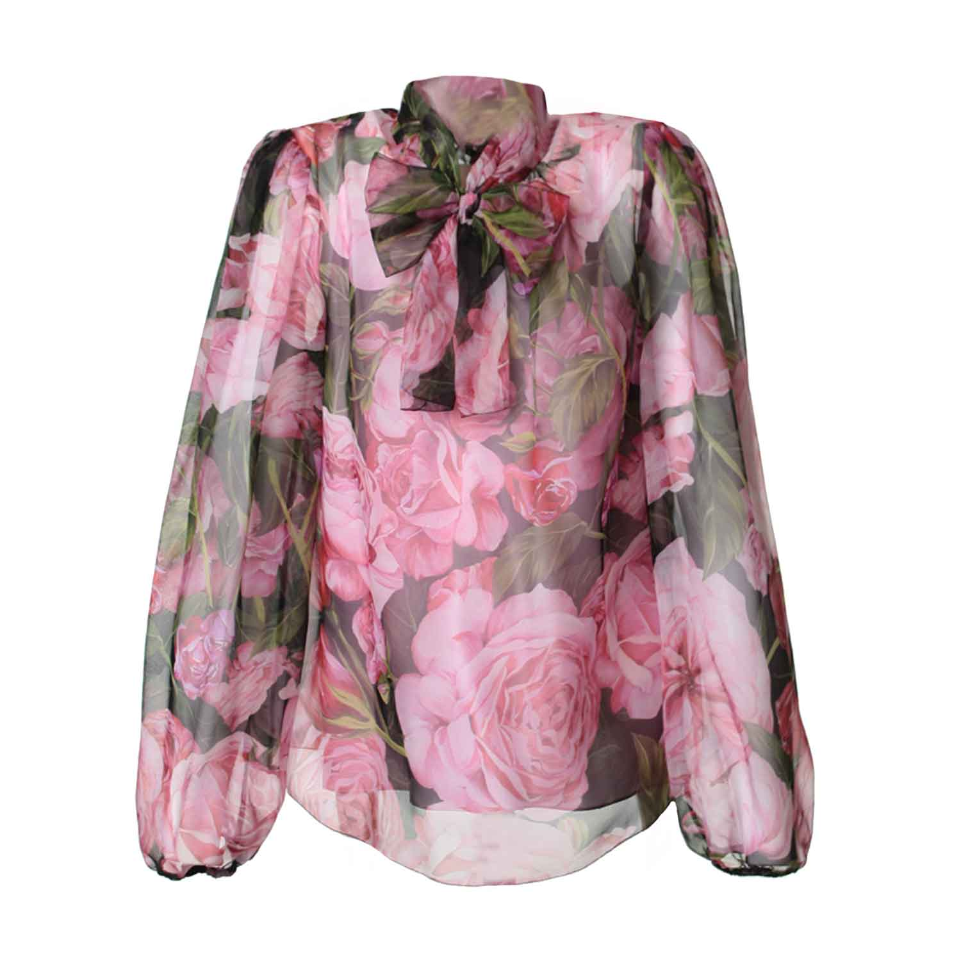
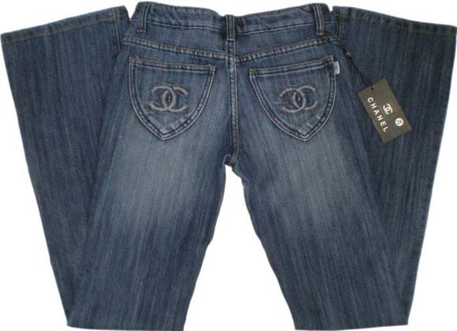
Among Top 5 future luxury spending categories, 3 are casual oriented
Luxury Casualwear
1
Global market trends
In which categories will your spending on luxury goods be affected the most and in which direction?
Index: % People expecting to increase spending - % of people expecting to decrease spending in that category
Pants & Skirts
Shirts
Sneakers
T-Shirt
Jeans
+39%
+38%
+37%
+35%
+34%
Overall True-Luxury consumers
expected spending increase
Top 5 categories
Source: BCG-Altagamma True-Luxury Global Consumer Insight Survey (12K + respondents in 10 countries)

Slide 8
Traditional luxury values still predominant; however, new values emerging among Chinese & Millennials
Luxury product values
2
Global market trends
Overall True-Luxury Consumers
Millennials
Traditional luxury values
Quality
Taste / style
Confidence / arrival
Enduring
Discerning
Power
Desire
...
77%
71%
78%
79%
73%
New luxury values
Extravagant & fun
Upbeat / positive
Creative
Daring & bold
23%
29%
22%
21%
27%
Extravagant & fun
Craftsmanship
Timeless
Cool & sexy
Highest positive difference vs. overall
An identity statement
Heritage
Craftsmanship
Innovation
Highest negative difference vs overall
Exclusivity
Brand iconic patterns
Adorned aesthetics
Craftsmanship
Adorned aesthetics
Extravagant & fun
Exclusivity
Superior quality
Source: BCG-Altagamma True-Luxury Global Consumer Insight Survey (12K + respondents in 10 countries)

Slide 9
New luxury values growing in the US and emerging globally at about 15% of market spend
Luxury product values
2
Belonging and understanding
Body positivity / acceptance
Fun and playful
Energetic and outgoing
Play / escape / create / intrigue
Resilient idealism
Inspired and excited
Daring and bold
Source: BCG

Slide 10
Luxury product values
2
Global market trends
Made-in US still lagging leaders, but slowly moving up
Which country of manufacturing do you consider the best for luxury products?
Respondents preference on made-in¹ (%)
Overall
Clothing
Handbags & shoes
Cosmetics & perfumes
Δ (pp)
30%
12
+17 pp
+18 pp
-2 pp
22%
4
11%
3
2014
2017
2014
2017
2014
2017
10%
0
+3 pp
+2 pp
+15 pp
7%
-4
5%
-1
2014
2017
2014
2017
2014
2017
…
+2 pp
+2 pp
+1 pp
3%
-2
2014
2017
2014
2017
2014
2017
1. Excluding cars, luxury boats, design and lighting
Source: BCG-Altagamma True-Luxury Global Consumer Insight Survey (12K + respondents in 10 countries)

Slide 11
Collaborations with streetwear & artists have a positive impact on young generations, and no impact on older ones
Collaborations
3
Millennials
"Thinking about special editions realized in collaboration with different brands / artists,
which of the following statements best applies to you?"
% of respondents
Overall
By Generation
Gen. Z
Millennials
Gen. X
Baby Boomer
Silver
88%
94%
94%
90%
76%
58%
Aware of Collaborations
Cool, new different styles
49%
40%
Special and unique collections
Something new without changing identity
11%
15%
16%
17%
9%
Indifferent
14%
Negative impact
3%
2%
2%
3%
7%
8%
Note: Selected most important answers
Source: BCG-Altagamma True-Luxury Global Consumer Insight Survey (12K + respondents in 10 countries)

Slide 12
Trading down attains ~54% for True-Luxury Millennials
Mix & Match
4
Millennials
"Thinking about your spending of 2/3 years ago and that of the last 12 months, do you have the feeling that you have partially shifted your spending from luxury brands to premium / fast fashion / niche or sports brands?
By Generation
47% of respondents have shifted from top luxury brands
Baby Boomers
Gen. Z
Millennials
Gen. X
Silver
23%
Shifted
41%
+6 pp
47%
45%
52%
54%
77%
Not shifted
59%
53%
55%
48%
46%
Source: BCG-Altagamma True-Luxury Global Consumer Insight Survey (12K + respondents in 10 countries)

Slide 13
~54% of Millennials shift from luxury brands; they trade down or mix styles buying niche brands
Mix & Match
4
Millennials
~54% of Millennials shift from top luxury brands
Relevant categories
Millennials
Luxury sports niche¹
22%
Sneakers, Backpacks, T-shirts
Yes
54%
Shifting niche
Luxury niche²
23%
Formal shoes, Sunglasses, Perfumes
26%
T-Shirts, Shirts, Jeans
Fast fashion
No
46%
Trading down
Premium
29%
Handbags, Perfumes, Watches
1. e.g. Lululemon or Sweaty Betty 2. e.g. Acne Studios, Mr & Mrs Italy, Aquazurra ecc
Source: BCG-Altagamma True-Luxury Global Consumer Insight Survey (12K + respondents in 10 countries)

Slide 14
Although they mix & match, Millennials report most loyalty across luxury brand categories
Brand loyalty
5
Millennials
True-Luxury Consumers
Baby Boomers
Gen. Z
Millennials
Gen. X
Silver
Loyal
31%
36%
Unloyal
69%
64%
Is there a brand on which you will increase your luxury spending?
39%
41%
44%
39%
28%
21%
Source: BCG-Altagamma True-Luxury Global Consumer Insight Survey (12K + respondents in 10 countries)

Slide 15
Instagram gaining space vs. Facebook and Youtube in the West; Wechat, Weibo and QQ leading among Chinese
Social Media
Global market trends
6
How would you rank the social media you use when interacting
with luxury brands, fashion bloggers?
Developed world¹
Chinese world
2017
Vs. 2016
2017
Vs. 2016
1
65%
70%
Tencent - Wechat
2
53%
55%
Weibo
3
48%
40%
1. Includes: US, UK, Italy, France, Germany
Source: BCG-Altagamma True-Luxury Global Consumer Insight Survey (12K + respondents in 10 countries)
Tencent - QQ

Slide 16
Influencers now top trusted source of information of True-Luxury Consumers, +29 pp vs. 2013 and flat vs. 2016
Influencers
Global market trends
7
"Which of the following online sources of information / channels impact how you develop opinions or make decisions about luxury purchases?"
2013
2016
2017
2
Magazines
50%
Magazines
39%
Social Media & Influencers
29%
10%
39%
Store windows
3
39%
Social Media & Influencers
38%
Magazines
37%
Brand websites
34%
Brand websites
33%
Brand websites
31%
Word of Mouth
Store windows
26%
Store windows
27%
TV & Movies
24%
TV & Movies
23%
Word of Mouth
Events
20%
Word of Mouth
19%
TV & Movies
20%
Celebrities
20%
Events
17%
Events
14%
Seen Worn
1
13%
Celebrities
16%
Seen Worn
14%
Social Media & Influencers
11%
Seen Worn
12%
Celebrities
13%
Influencers
Social media
Note: Multiple options answer (ranking of three levers)
1. Includes Social Media, Online blogs & Influencers; 2. Editorials and Commercial in Magazines. Includes both traditional & digital magazines; 3. Includes also Brand's App
Source: BCG-Altagamma True-Luxury Global Consumer Insight Survey (12K + respondents in 10 countries)

Slide 17
Stores stabilizing, driven by US; online only growing due also to US
Omnichannel
Global market trends
8
a
Last purchase channel evolution
Signs of Store-solo stabilization driven by US (up 12 pp) True Luxury Consumers & younger generations
Omnichannel stabilizing for the 1st year; however, future growth expected to come from Millennials 'omni' attitude
Online only continues to grow driven mainly by older generations in mature countries (i.e., promotional activity in US)
48%
Omnichannel
12%
100%
Online only
7%
10%
9%
b
Showrooming
8%
39%
ROPO
38%
46%
51%
42%
Omnichannel
40%
c
Store solo
47%
39%
2013
2016
Store-solo
ROPO
1
2
Showrooming
Online
only
Total
1. Researched Online, Purchased Offline
2. Researched Offline, Purchased Online
Note: referred to last purchase
Source: BCG-Altagamma True-Luxury Global Consumer Insight Survey (12K + respondents in 10 countries)
a
b
c

Slide 18
3 channels dominate True-Luxury online ecosystem, counting for ~90%
Online ecosystem
9
Global market trends
Luxury online ecosystem dominated by Mono-brand online, Full-price multi-brand & Generalist marketplaces (~90% of the last purchases online)
Mono-brand online preferred in mature markets & by older generations, Generalist strong in China, and Multi-brand amongst Millennials
Online ecosystem varies broadly across luxury categories and geographies, notably China
33%
32%
23%
Mono-brand website
(e.g. Brand.com)
Full-price multi-brand
(e.g. NAP, Farfetch)
Generalist marketplaces
(e.g. Amazon, T-mall, Alibaba, JD)
6%
4%
2%
Off-price
e-tailers
(e.g Yoox)
Online
flash sales
(e.g. Vente-privee, VIP)
Social Media linked sales (e.g. WeChat, C2C)
Note: referred to last purchase
Source: BCG-Altagamma True-Luxury Global Consumer Insight Survey (12K + respondents in 10 countries)

Slide 19
Breadth and customization key to mono-brand online, while department store about range and exposure
Online ecosystem
9
Global market trends
Which are the most important reasons to you to shop in the following online channels?
Mono-brand online
Full-price multi-brand
Generalist marketplace
40%
Wide range of products of preferred brand
34%
Wide range of brands
39%
Home delivery
30%
Home delivery
34%
Wide range of products of preferred brand
38%
Wide range of brands
26%
Opportunity to customize the products
24%
Opportunity to find niche brands & products
34%
Lower prices vs. physical store
Source: BCG-Altagamma True-Luxury Global Consumer Insight Survey (12K + respondents in 10 countries)

Slide 20
Purchases perceived to be additional to physical retail flattening at 60%; more perceived cannabilization in US
Online ecosystem
9
Global market trends
"Do you have the feeling that your spending online is in addition to or cannibalizing your luxury spending in physical stores?"
True-Luxury Global Consumers
By nationality
45%
In addition to physical
55%
51%
50%
48%
47%
42%
Cannibalization
44%
43%
41%
30%
27%
Source: BCG-Altagamma True-Luxury Global Consumer Insight Survey (12K + respondents in 10 countries)

Slide 21
Mobile prevailing over PC for online shopping, driven by Chinese and youth; further increases expected
Online ecosystem
9
Global market trends
"Which device did you use to buy this item online?"
All True-Luxury Consumers
From Generation Z … to Silver
… to Chinese
27%
19%
55%
55%
66%
75%
77%
Device (smartphone, tablet)
80-90%
73%
81%
45%
45%
34%
25%
23%
10-20%
Personal computer (laptop)
2014
2017
2024E
Gen. Z
Millennials
Gen. X
Baby Boomers
Silver
Note: Referred to last purchase; % of people using device vs. personal computer / people buying online
Source: BCG-Altagamma True-Luxury Global Consumer Insight Survey (12K + respondents in 10 countries)

Slide 22
Mono-brand still the most used channel by True-Luxury Consumers, gaining back some ground vs. Dep't Stores
Mono-brand store
10
Global market trends
"Which kind of store did you buy the product from?"
Reasons to purchase in mono-brand stores
True-Luxury Global Consumers
Online
16%
19%
20%
#1
Try & touch the product
Other Physical Stores
7%
6%
6%
Shopping mall
6%
7%
6%
#2
Offer range of the brand
High-end dept store
20%
17%
22%
#3
Intimate and relaxed environment
Multi-brand
16%
19%
19%
#4
Convenient location, easy reach
Mono-brand
35%
27%
32%
#5
Personal relationship with sales associate or personal shopper
Note: Referred to last purchase
Source: BCG-Altagamma True-Luxury Global Consumer Insight Survey (12K + respondents in 10 countries)

Slide 23
Consumers suggest in-store experiences and services, vs. product, would drive increased store traffic
Mono-brand store
10
Global market trends
Which are the reasons for which you are and would purchase more frequently in a mono-brand physical store?
ranking
% of respondents
True-Luxury Global Consumers
Latest products including special editions
#1
27%
Sales associate gives me advice on latest trends
#2
21%
Products I cannot find online
#3
21%
Offers experiences in store
#4
20%
Unique event in store to which I am invited
#5
20%
Reasons related to experiences, special products
Store has different product assortments in each city I visit
#6
19%
Other reasons
Source: BCG-Altagamma True-Luxury Global Consumer Insight Survey (12K + respondents in 10 countries)

Slide 24
10 trends relevant for the True-Luxury Consumers
1. Luxury casualwear: keeps increasing vs formal with 73% appeal, +7pp YoY, also driven by "forever young" behaviors
2. Luxury product values: traditional values as quality hold but new values as "extravagance & fun" key to success
3. Collaborations: cover demand for newness, give a cool edge, strengthen brand awareness & willingness to buy
4. Mix and match: ~55% Millennials partially shift from luxury brands to trade down or mix styles buying niche brands
5. Brand loyalty: Millennials the generation with highest brand loyalty across categories - 36% are loyal vs. 30% overall
Product & Branding
"What they want"
6. Social media: social media keep booming - from 9th in 2013 to 1st lever in 2017 on True-Luxury consumers
7. Influencers: within social media, influencer power booming because of perceived authenticity
"How to reach them"
Communication & Media
8. Omnichannel: achieved ~50%. Online-solo keeps growing with older consumers. Store-solo shows signs of recovery
9. Online ecosystem: evolving with regional differences (brand.com vs multi-brand vs generalist marketplaces shares)
10. Mono-brand stores: stabilizing due to luxury brands' efforts –"Special product" offer, in-store experience improvement
Sales
Channels
"Where they buy"
Source: BCG-Altagamma True-Luxury Global Consumer Insight Survey (12K + respondents in 10 countries)

